Slide 1
TCP v/s UDP
Sachin Aryal
Sec :B

Slide 2
TRANSPORT LAYER
TCP
UDP

Slide 3
UDP - User Datagram Protocol
Used mainly for one way, short communications
datagrams don’t contain information about other packets
Each packet independent of each other
Messages can be no larger than the max UDP packet size

Slide 4
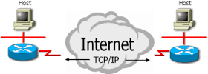
TCP (Transmission Control Protocol)
Connection-oriented service.
Telephone line
Similarly, in a network, the service user will
Establish a connection
Use the connection
Release the connection
The sender, receiver and the network may conduct a negotiation about data transfer speed, maximum message size, etc

Slide 5
Different Applications of TCP and UDP
Web browsing, email and file transfer are common applications.
TCP is used to control segment size, rate of data exchange, flow control and network congestion.
TCP is preferred where error correction facilities are required at network interface level.
UDP is largely used by time sensitive applications as well as by servers that answer small queries from huge number of clients.
UDP is commonly used in Domain Name System, Voice over IP, Trivial File Transfer Protocol and online games.

Slide 6
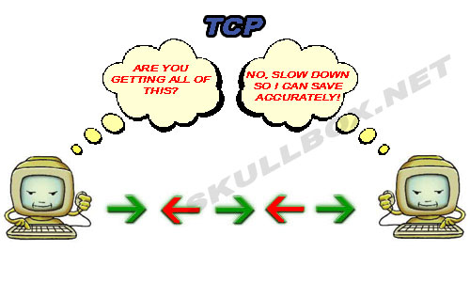
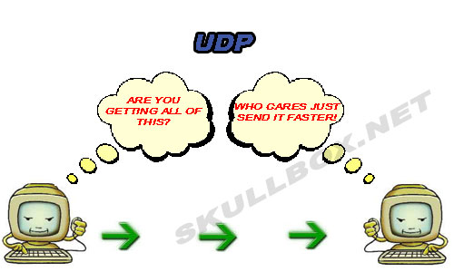
How TCP and UDP Works?

Slide 7
TCP vs UDP
TCP has a more complex frame structure. This is due to the fact that TCP is a connection-oriented protocol. The extra fields are need to ensure the guaranteed delivery offered by TCP.
UDP is suitable for applications that need fast, efficient transmission, such as games. UDP's stateless nature is also useful for servers that answer small queries from huge numbers of clients.

Slide 8
Use of TCP and UDP by other Protocols
TCP : HTTP, HTTPs, FTP, SMTP.
UDP : DNS, VOIP.

Slide 9
Thank You

